Slide 1
Final Project : From Photographic to Anime
The Diffusion Group
Nathaniel Takeshi
Gifary
Nyoman
Abie
Fairuuz
Alex (Mentor)

Slide 2
Background
All the members are heavily interested in Diffusion Model, and through this opportunity, an educated experiment becomes an approach to learn it further
To properly learn about Diffusion Model basics by doing this project
Main task: Train an UNSB model to transfer a style of one image to another
We focus on the dataset preparation and making the model trainable on our compute devices
We wanted to gain experience on training Diffusion Models and what does it take for someone to do it from scratch

Slide 3
Dataset
We used a combination of LHQ Dataset and a custom-made, Shinkai-style image dataset
The Shinkai-style image dataset is consisted of 8 movies, which is extracted frame-by-frame
Total images: 4581 images
Resolution: 1080 x 1080
Motivation: "We think it’s interesting to see how UNSB could really change images photographic to cinematic, like anime"
LHQ Dataset is comprised of 90,000 images of HD landscape images
Reference: https://github.com/Yuxinn-J/Scenimefy

Slide 4
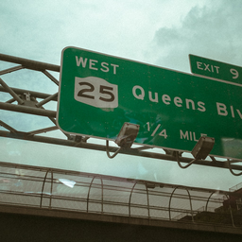
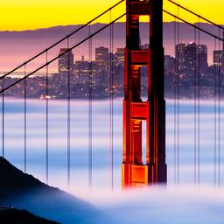
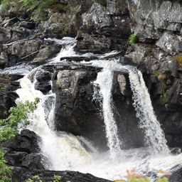
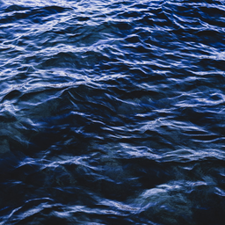
Overview LHQ Dataset
Contains Landscape Photos
Total Images : 90,000 images
Resolution : 256x256

Slide 5
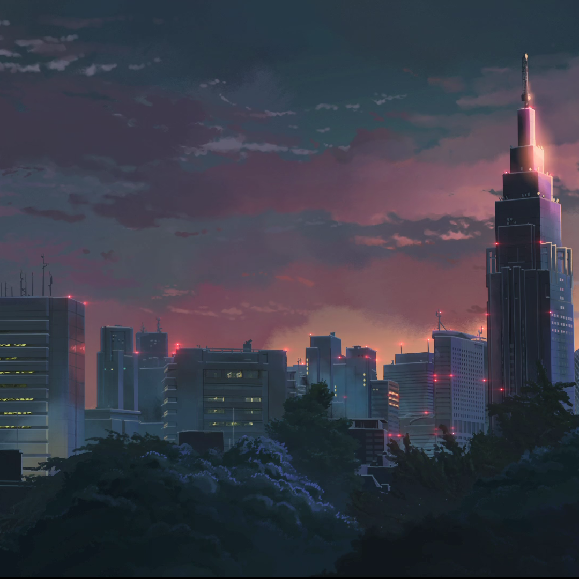

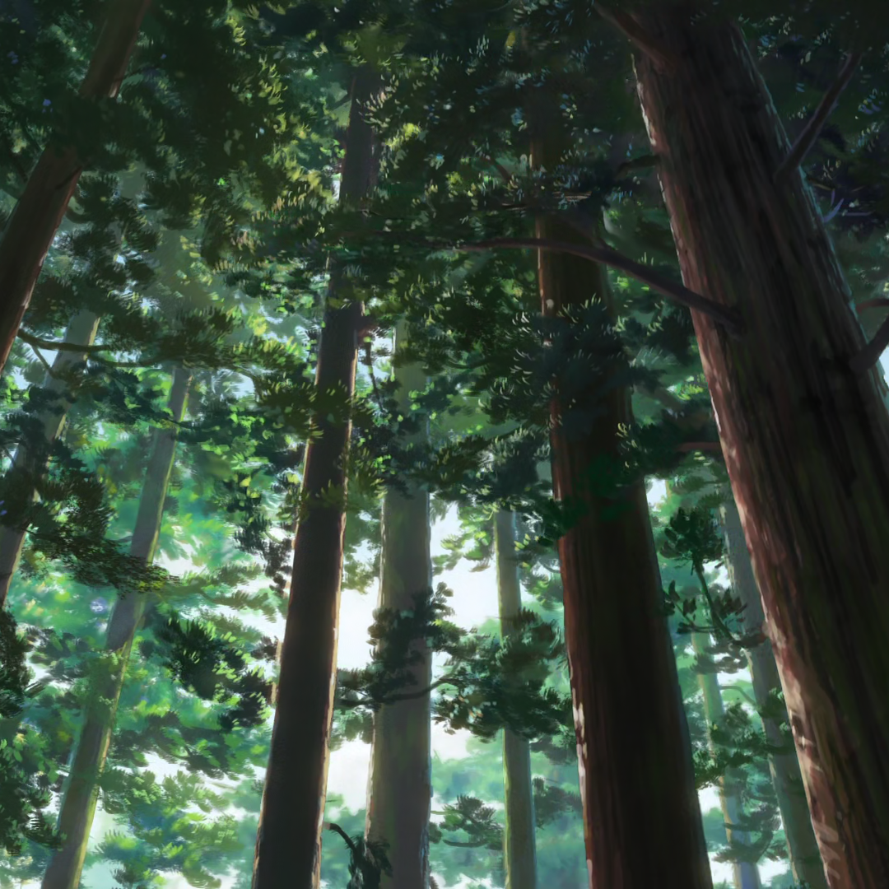
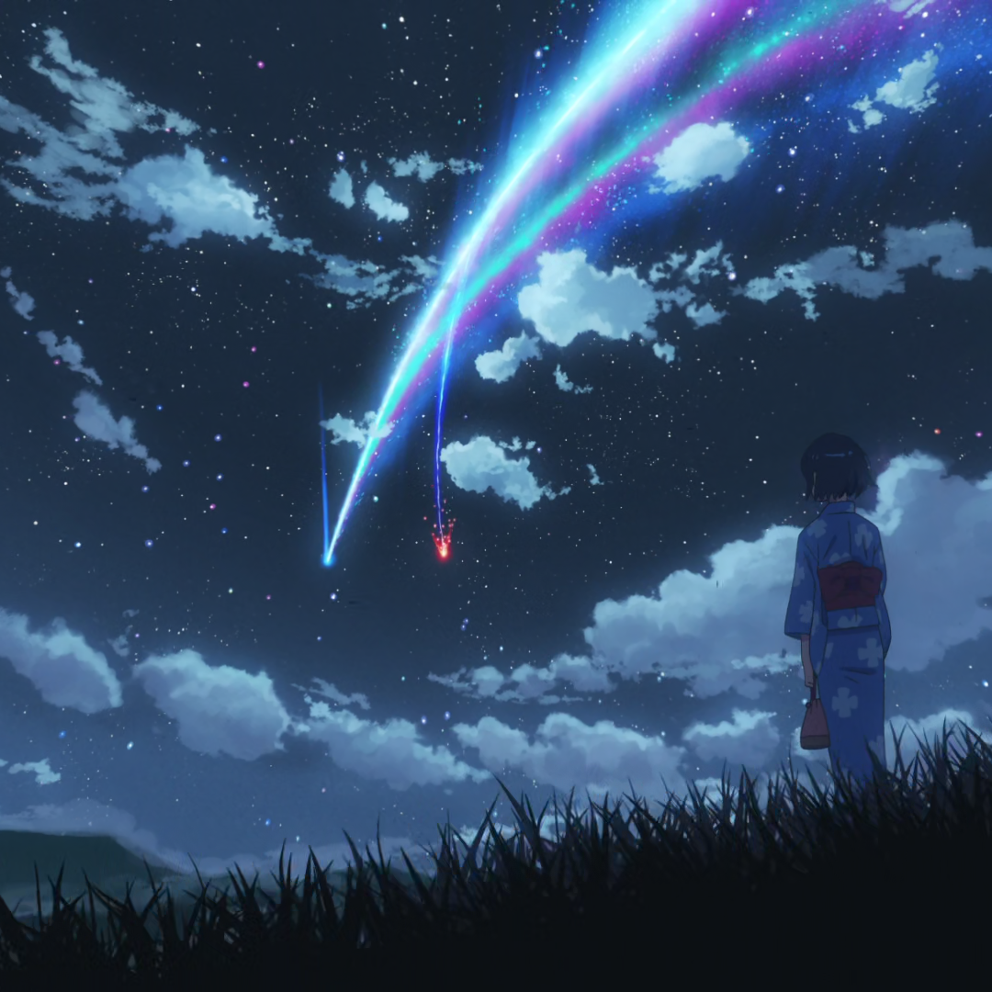
Shinkai-Style Sources
Contains Scenes of Makoto Shinkai Anime Movie
Total Images : 4,581 images
Resolution : 1080x1080

Slide 6
Shinkai-Style Sources (cont.)
Movie Name | Size | Duration | Frame | Frame#
5 Centimeters Per Second | 1.89 GB | 01:02:45 | 1920 x 1080 | 246
A Gathering of Cats | 12.1 MB | 00:01:02 | 1920 x 1080 | 5
Children Who Chase Lost Voices | 2.14 GB | 01:56:07 | 1920 x 1072 | 525
The Garden of Words | 1.08 GB | 00:46:01 | 1920 x 1080 | 181
Someone's Gaze | 61.0 MB | 00:06:44 | 1930 x 1080 | 17
Cross Road | 31.0 MB | 00:01:58 | 1920 x 1080 | 22
Your name | 1.63 GB | 01:46:35 | 1920 x 1080 | 413
Weathering with You | 2.67 GB | 01:52:20 | 1920 x 1080 | 307

Slide 7
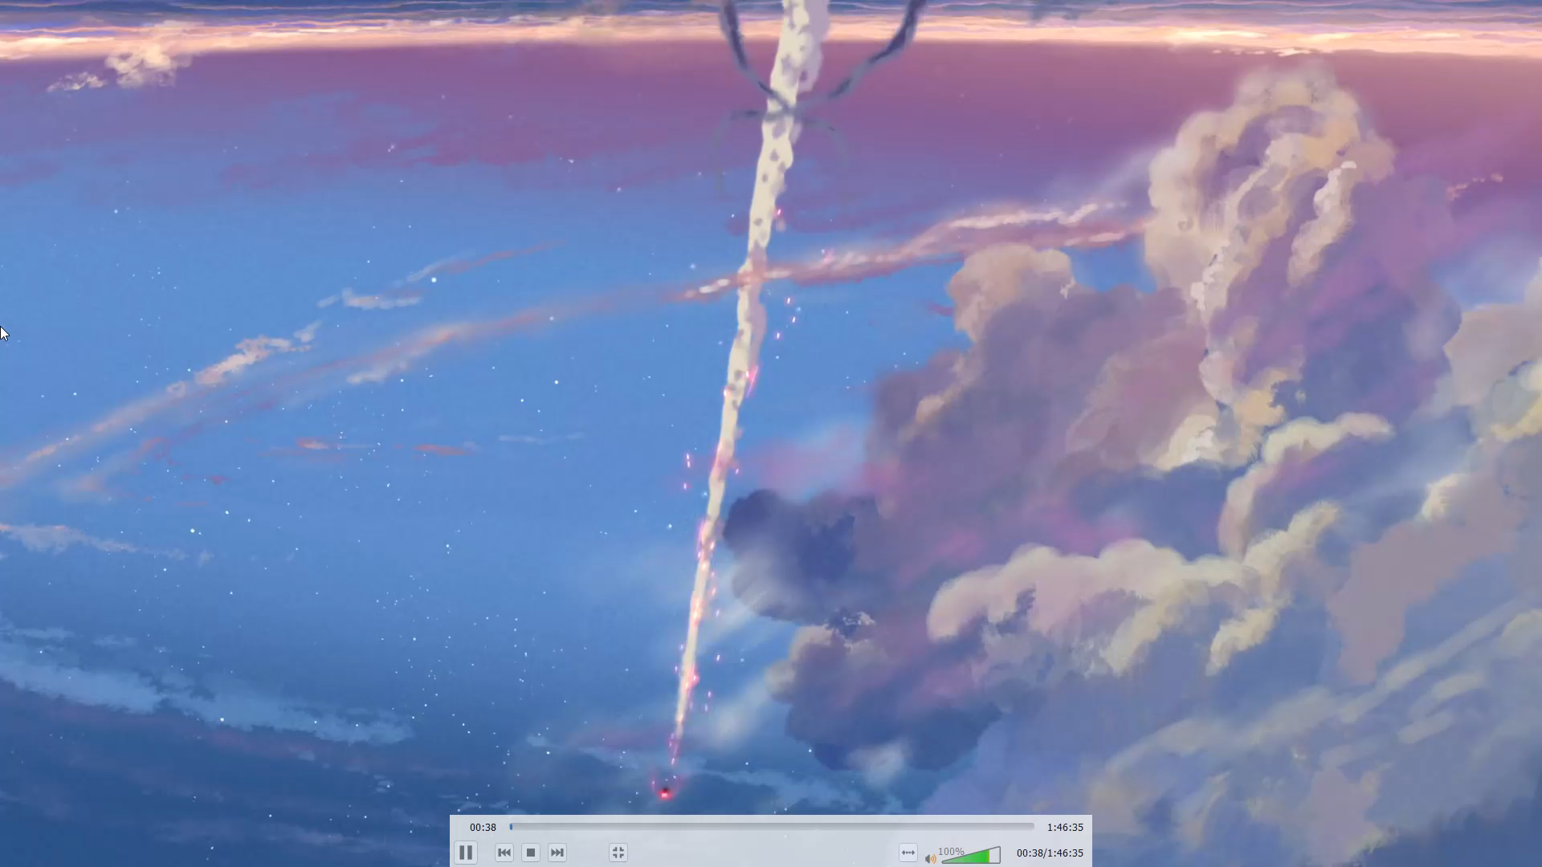
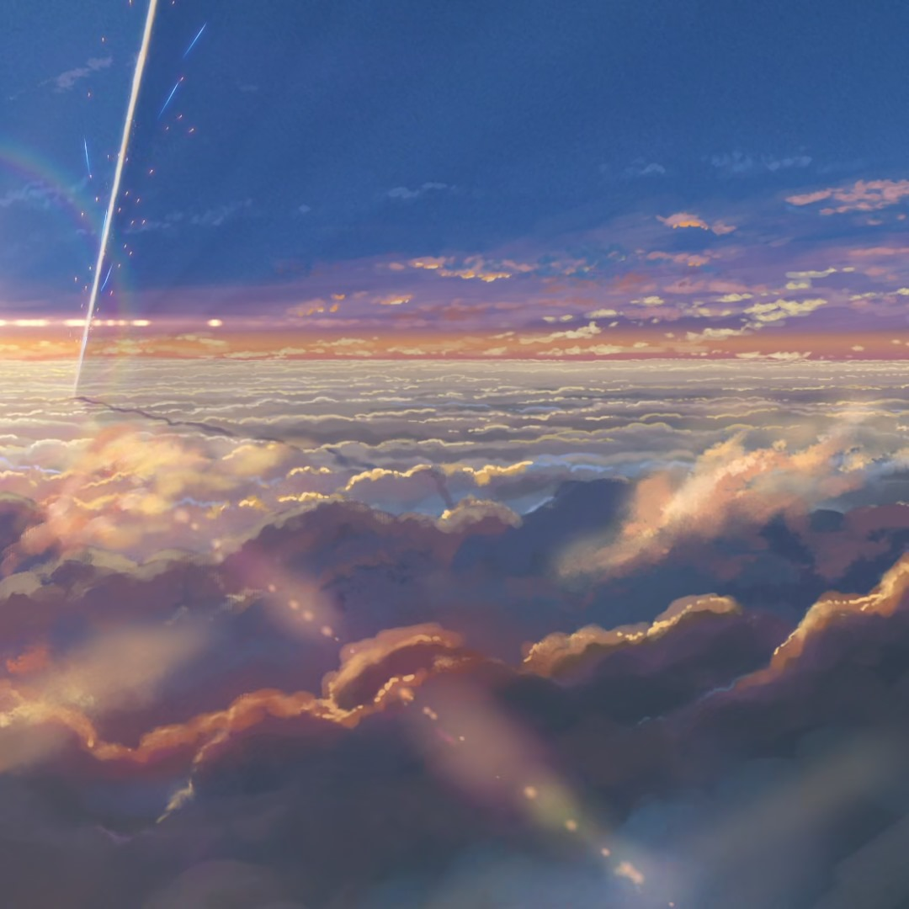
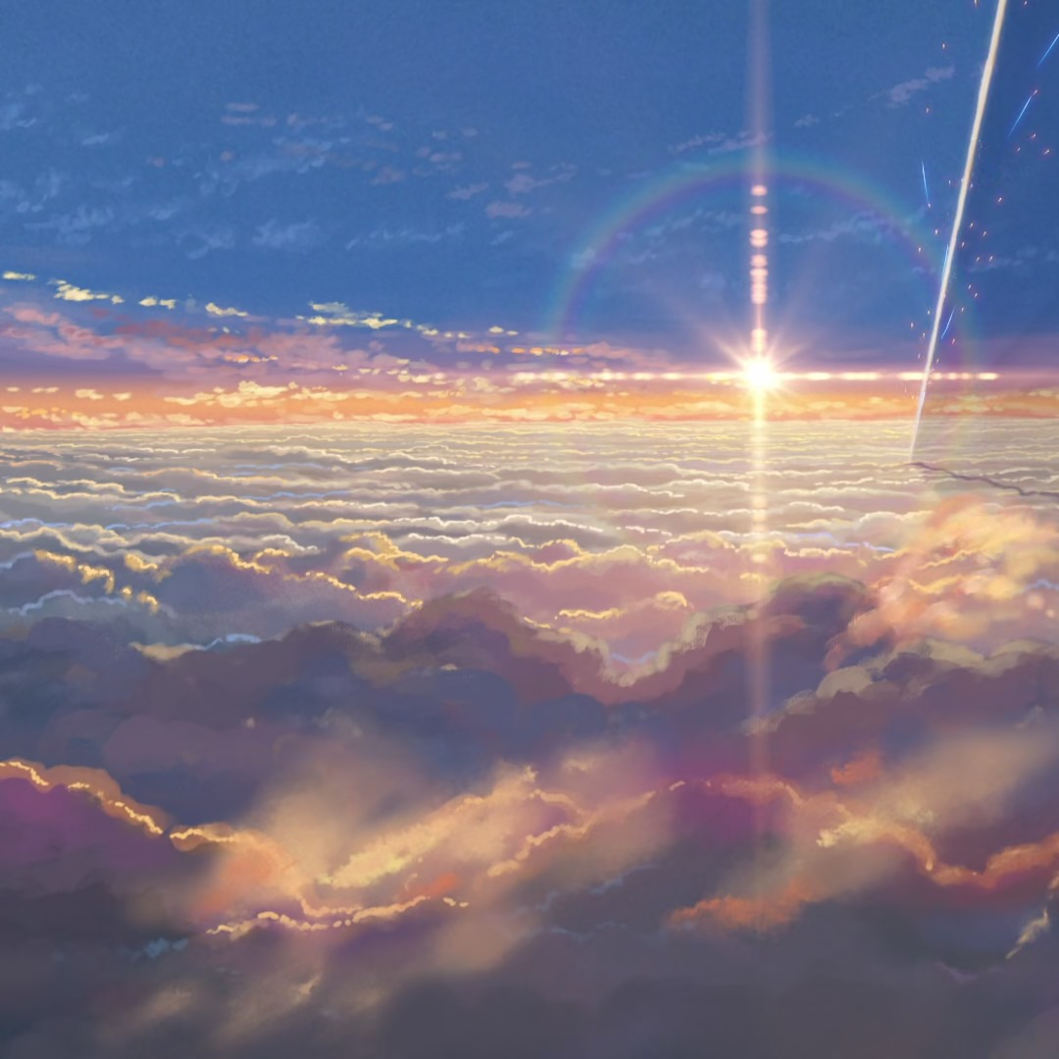

Movie scenes
Extracted Images

Slide 8
UNSB 101
UNSB stands for Unpaired Image-to-Image Translation via Neural Schrödinger Bridge
A method to combine 2 arbitrary Gaussian Distributions
This makes the model performs well for unpaired image-to-image translation tasks
Diffusion Models are prone to Entropy-Regularized Optimal Transport (OT) problem
This was caused by the Diffusion prior used by these models to generate content
Thus, not suitable for unpaired image-to-image translation tasks
UNSB tries to solve the problem by combining both distributions by interpolating the source domain with the target domain
Reference paper: https://arxiv.org/abs/2305.15086

Slide 9
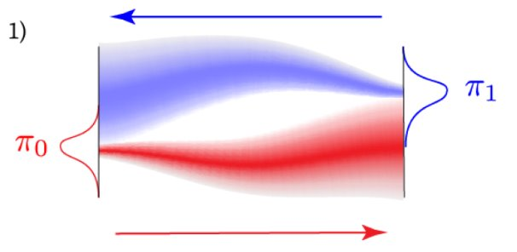

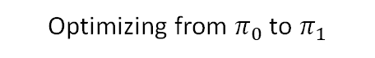
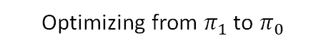
Distribution Interpolation
Attempt to “connect”
Optimizing from $π_{1}$ to $π_{0}$
Optimizing from $π_{0}$ to $π_{1}$

Slide 10
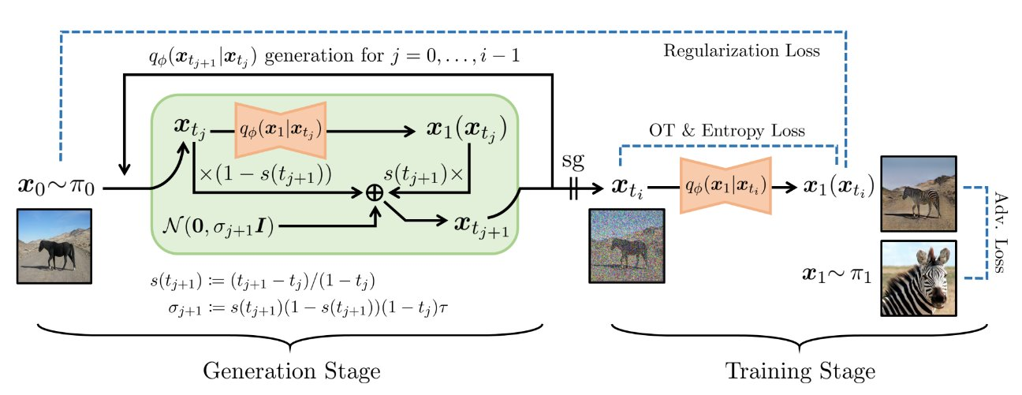
UNSB Architecture

Slide 11
Excuses & Limitations
We trained our model up to the 6th Epoch, at the 3000th iteration (each epoch did around 50K+ iterations)
It took us 2 days to reach this point using 1x GTX 1080Ti GPU
The training session stopped at Friday, June 20th, 2024, at 16.38 Taipei Standard Time
We kept the model checkpoint just in case someone wants to continue the training
Training stopped as one of the lab members wanted to use the computer for another project
Lack of manpower as 80% of the members are working on their thesis and other lab project
The coordinator stepped in to help us train the model by providing lab computer
We also used a lot of hyperparameter tuning to reduce the size of the model
The model is not 'perfect', but trainable on our devices
Another round of tuning (and documentation) should be done for future works

Slide 12
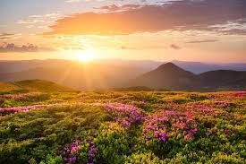
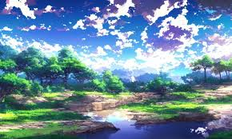
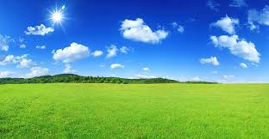
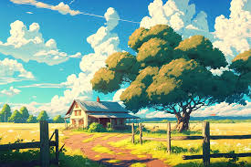
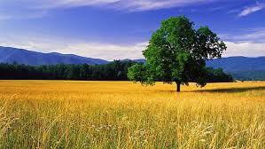
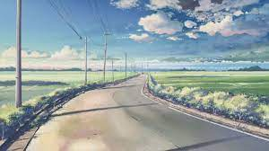
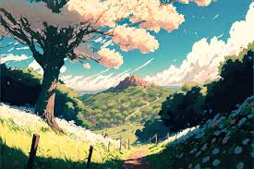
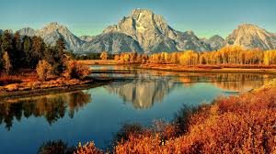
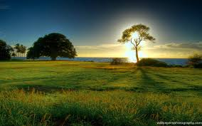

Our expectations…
via Diffusion Model with
Schrödinger Bridge

Slide 13
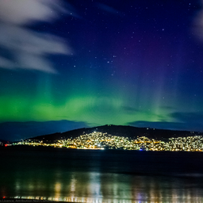
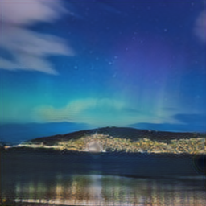
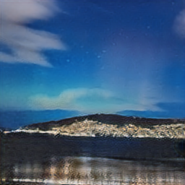
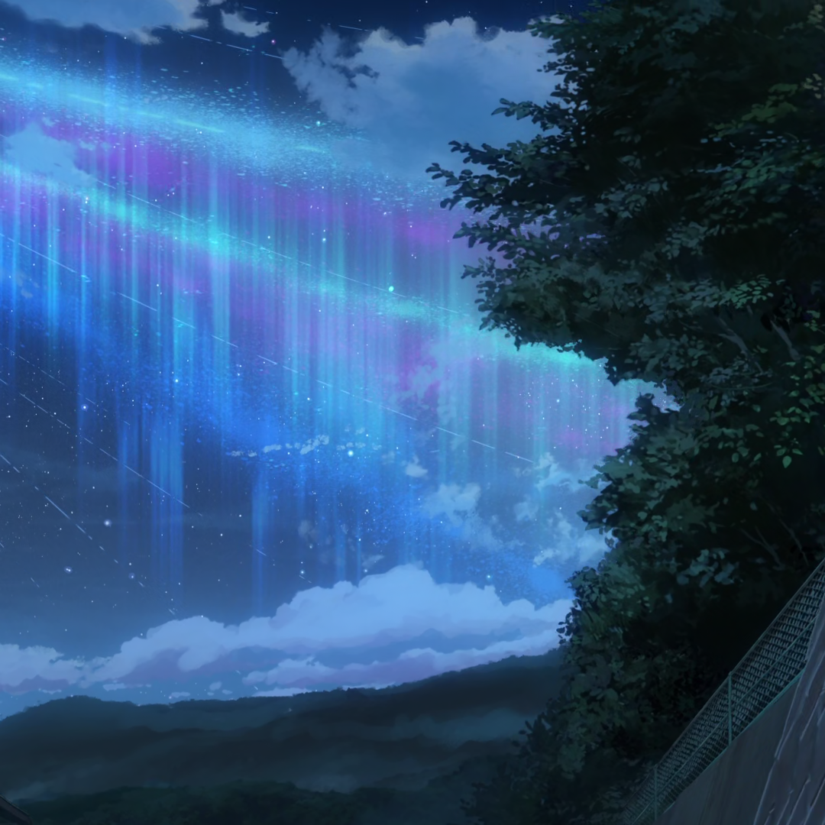
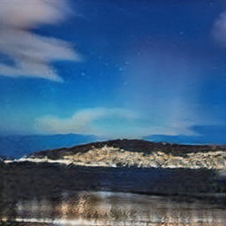
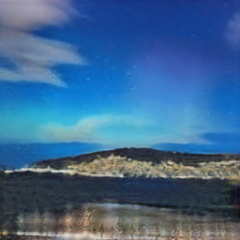
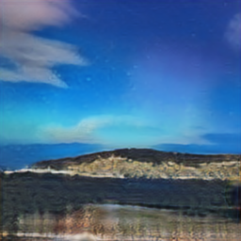
Training Result
Possible Reference
Real one
Kimi no Nawa’s Snapshot
Want more? Click here

Slide 14
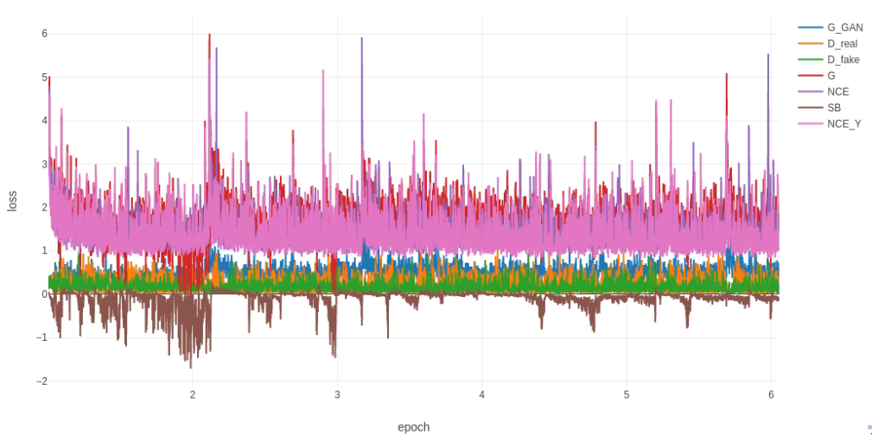
Loss curves
Notes:
The loss curve is still chaos, but we

Slide 15
Remark
Even so, the journey enables us to slowly understand Diffusion Model in research-level
Provides some motivations to do much more experimentation in Diffusion Model in the future
Rigorous consideration for experiment preparation is needed
Also, a good GPU (important)
An in-depth mathematics knowledge is extremely demanding, yet could be caught up later
Specifically, Stochastic Differential Equation and Mathematical Statistics played the core roles

Slide 16
QnA
That’s it! Any questions?

